Slide 1
Potential Changes to Election Precincts
Spring 2025

Slide 2
Why are there potential changes?
Verification every spring of odd-numbered years
Verification that election precincts meet Texas Election Code requirements from Section 42
42.005
42.006
42.007
Any changes must be voted in by Commissioners’ Court before May 1
Changes take affect on Jan 1 of next even-numbered year (1/1/26)

Slide 3
TEC 42.002
Verify that all the election precincts’ sub-precincts share the same ‘Big 6’ or “major” districts
US Congress
State Board of Education
State Senate
State Representative
County Commissioner
Justice of the Peace
These districts cannot change except every 10 years

Slide 4
TEC 42.006
Verify population of active registered voters is between 100 and 5000
Election precincts can be split or merged
Splitting election precincts when the election precinct reaches 4200-4500 depending on growth in that area is the ideal
Unofficial evaluation of potential growth from now until 01/01/2028
Merging precincts to attempt over 1000 voters in each precinct

Slide 5
TEC 42.006
Items to consider
Do not cross ‘Big 6’ lines
When splitting or merging: Ratio of Democratic and Republican election precincts needs to remain the same or as close as possible
Smith Currently: 21% Democratic and 79% Republican
Smith with potential changes: 21.2% Democratic and 78.8% Republican
Do not merge Democratic and Republican election precincts to each other
When splitting: Would another polling place be needed?

Slide 6
TEC 42.007
In a county with a city of 10,000 or more, election precincts need to be all unincorporated territory or all incorporated territory
Not always possible - ‘Big 6’ and population requirements of 100-5000
City of Tyler
GIS looks at the annexed areas
Can we move an election precinct line?
Can the area form its own precinct population wise?
Annexed territory in Pct. 42 near Pct 74

Slide 7
Potential Changes-Splits and Merges
Pct. 19 (Lindale): 4,248
Pct. 42 (Noonday): 4,346
Pct. 71 (S Tyler): 4,262

Slide 8
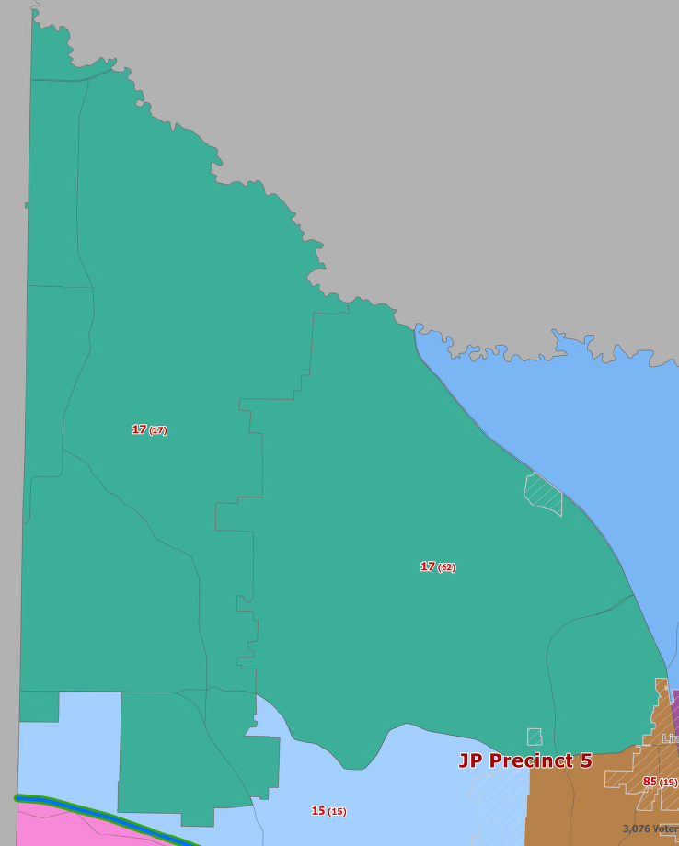
Potential Changes
Section 1 – NW Smith County
Merge Pct 17 and 62 for a total of around 3434 active voters

Slide 9
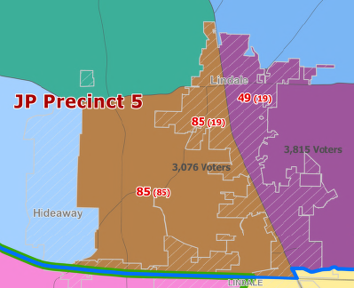
Potential Changes
Section 1 – NW Smith County
Merge Pct 85 and the western portion of Pct 19 for a total of around 3076 active voters

Slide 10
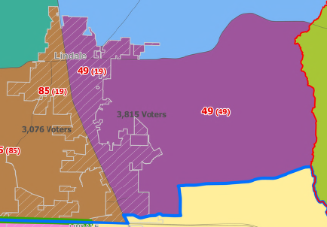
Potential Changes
Section 1 – NW Smith County
Merge Pct 49 and the eastern portion of Pct 19 for a total of around 3815 active voters

Slide 11
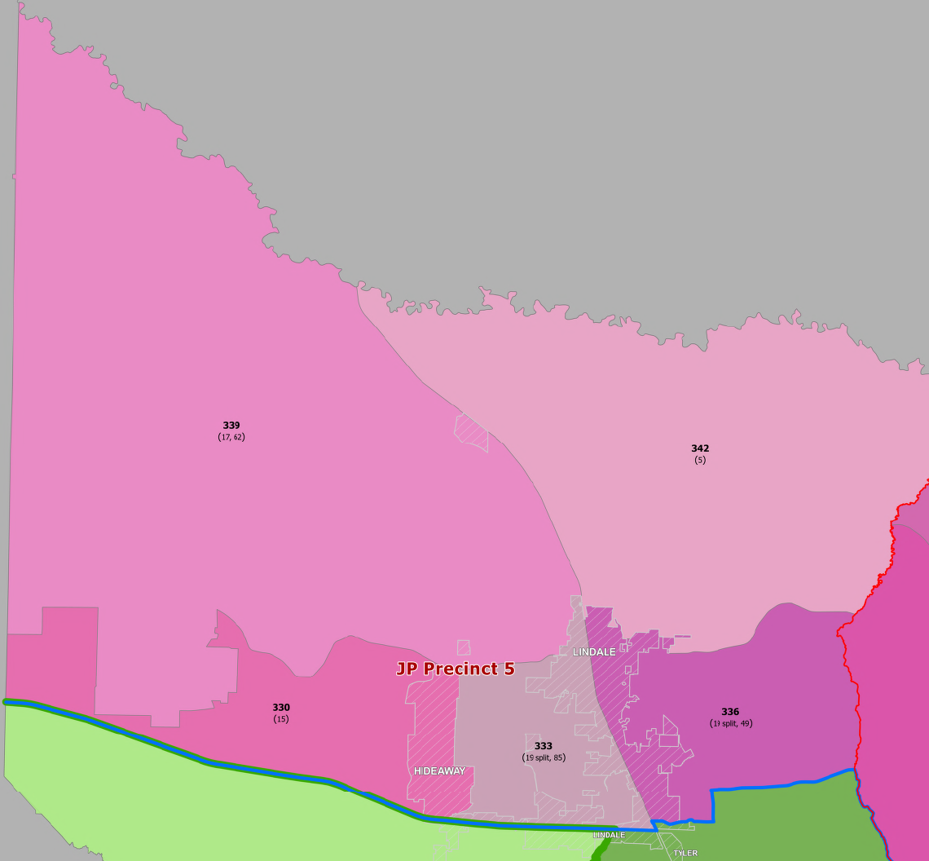
Potential Changes
Section 1 – NW Smith County
Merge Pct 17 and 62 for a total of around 3434 active voters (Pct 339)
Merge Pct 85 and the western portion of Pct 19 for a total of around 3076 active voters (Pct 333)
Merge Pct 49 and the eastern portion of Pct 19 for a total of around 3815 active voters (Pct 336)

Slide 12
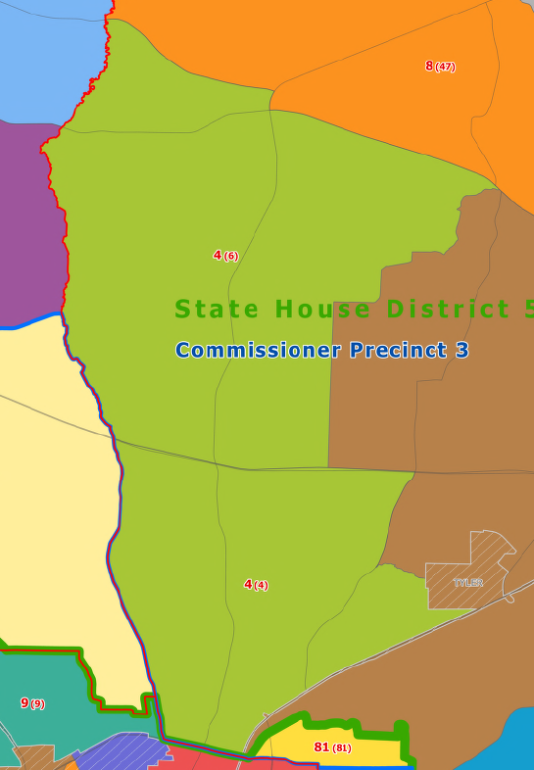
Potential Changes
Section 2 – NE Smith County
Merge Pct 4 and 6 for a total of around 2869 active voters

Slide 13
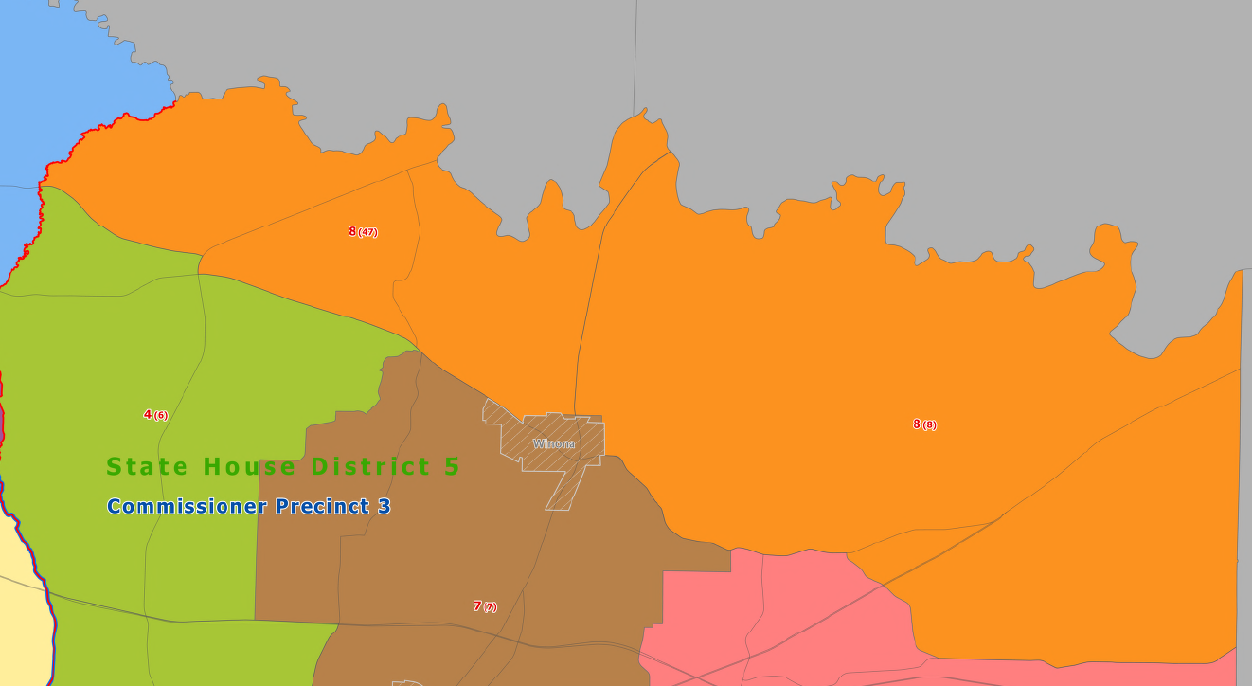
Potential Changes
Section 2 – NE Smith County
Merge Pct 8 and 47 for a total of around 2084 active voters

Slide 14
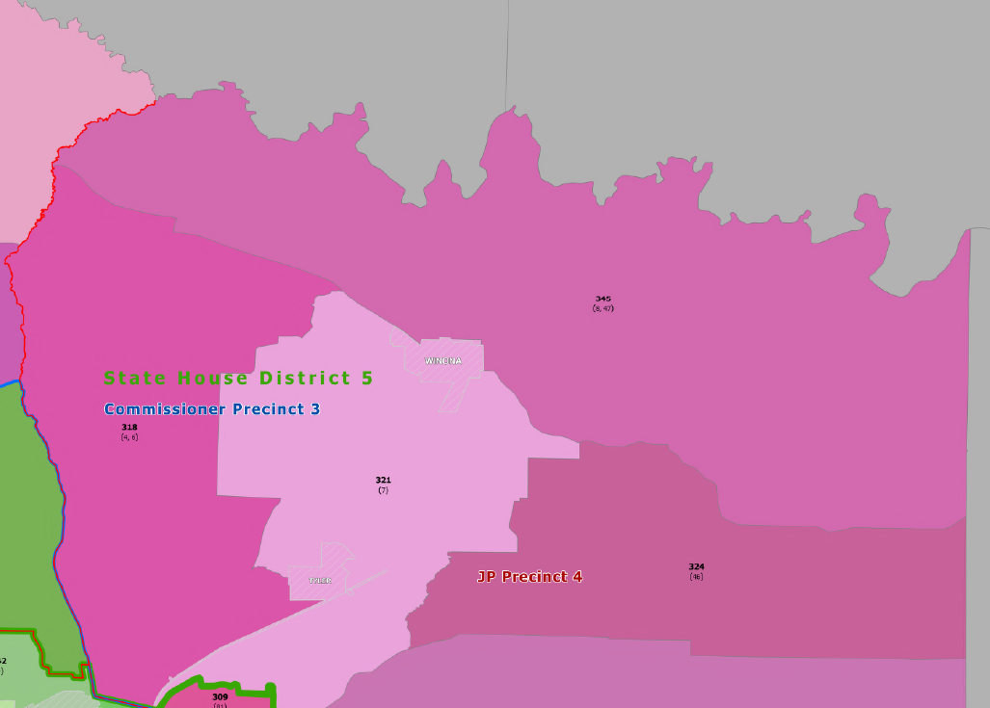
Potential Changes
Section 2 – NE Smith County
Merge Pct 4 and 6 for a total of around 2869 active voters (Pct 318)
Merge Pct 8 and 47 for a total of around 2084 active voters (Pct 345)

Slide 15
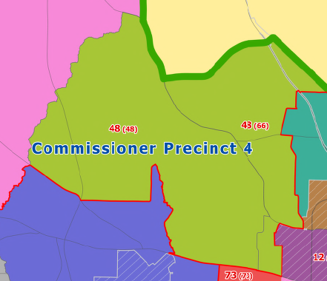
Potential Changes
Section 3 – NW (S of 20) Smith County
Merge Pct 48 and 66 for a total of around 1861 active voters

Slide 16
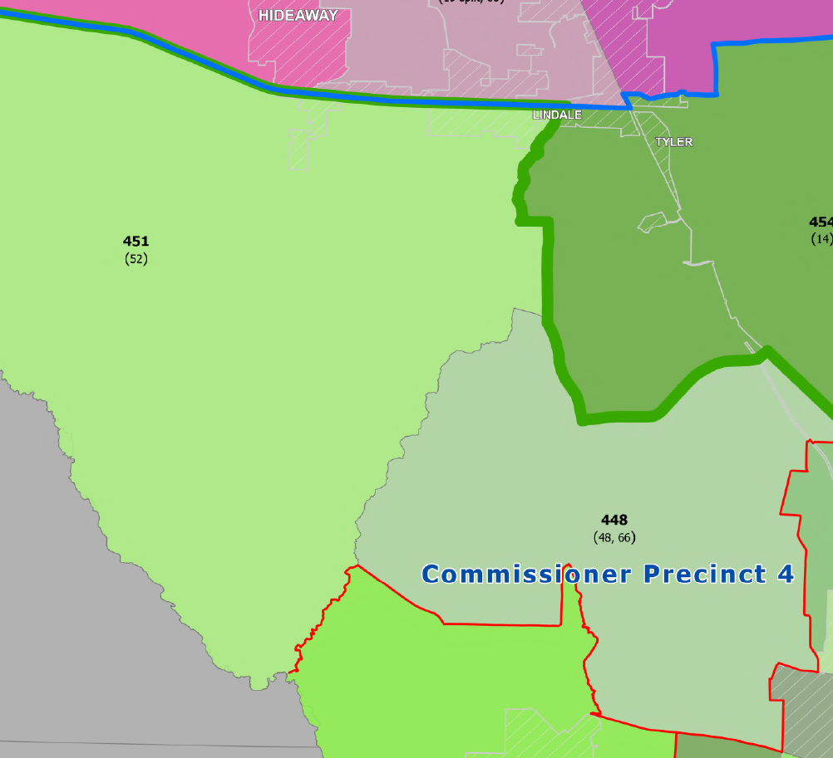
Potential Changes
Section 3 – NW (S of 20) Smith County
Merge Pct 48 and 66 for a total of around 1861 active voters (Pct 448)

Slide 17
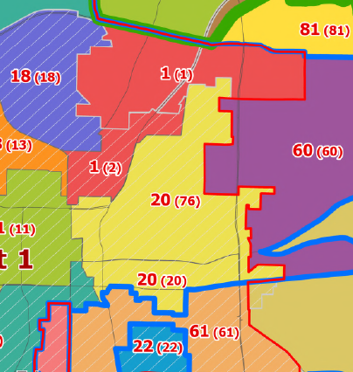
Potential Changes
Section 4 – North Central Smith County
Merge Pct 1 and 2 for a total of around 1260 active voters
Merge Pct 20 and 76 for a total of around 1536 active voters

Slide 18
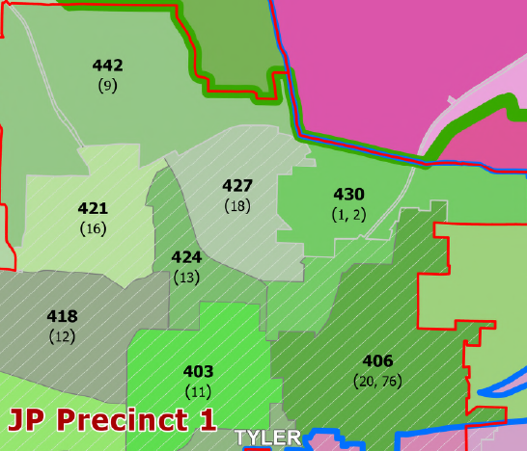
Potential Changes
Section 4 – North Central Smith County
Merge Pct 1 and 2 for a total of around 1260 active voters (Pct 430)
Merge Pct 20 and 76 for a total of around 1536 active voters (Pct 406)

Slide 19
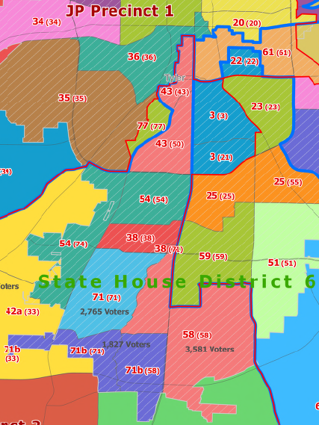
Potential Changes
Section 5 – SW Smith County
Merge Pct 43 and 50 for a total of around 3390 active voters

Slide 20
Potential Changes
Section 5 – SW Smith County
Merge Pct 54 and 74 for a total of around 3777 active voters, this includes more recently incorporated territory

Slide 21
Potential Changes
Section 5 – SW Smith County
Split Pct 71 in ½
Section N of Cumberland for around 2765 active voters
Section S of Cumberland with portion of 58 (west of Broadway and south of Cumberland) added for around 1827 active voters

Slide 22
Potential Changes
Section 5 – SW Smith County
Keep remainder of Pct 58 as a stand-alone pct of around 3581 active voters

Slide 23
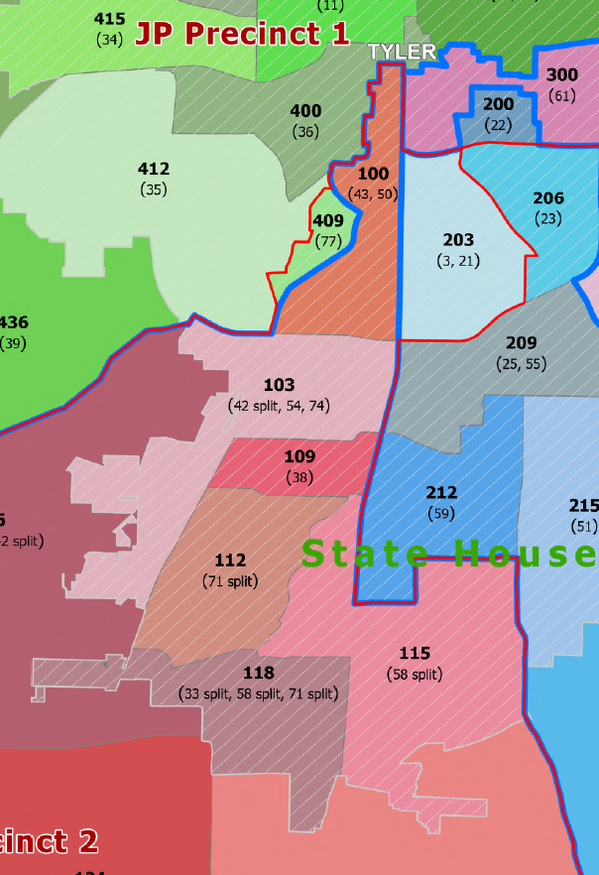
Potential Changes
Section 5 – SW Smith County
Merge Pct 43 and 50 for a total of around 3390 active voters (Pct 100)
Merge Pct 54 and 74 for a total of around 3777 active voters, this includes more recently incorporated territory (Pct 103)
Split Pct 71 in ½
Section N of Cumberland for around 2765 active voters (Pct 112)
Section S of Cumberland with portion of 58 (west of Broadway and south of Cumberland) added for around 1827 active voters (Pct 118)
Keep remainder of Pct 58 as a stand-alone pct of around 3581 active voters (Pct 115)

Slide 24
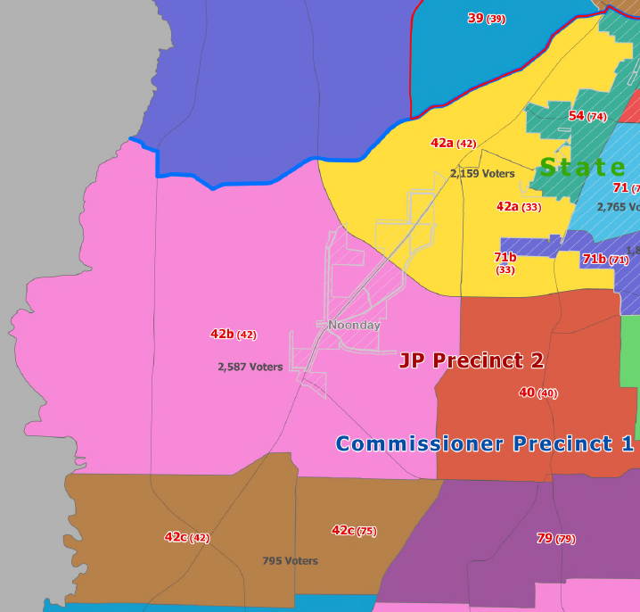
Potential Changes
Section 5 – SW Smith County Continued
Split Pct 42 into 3 parts
Section N of 49 is added to Pct 33 for around 2159 active voters
Middle section of Pct 42 with around 2587 active voters
Bottom section of Pct 42 split into a new pct and combined with part of Pct 75 for a total of around 795 active voters

Slide 25
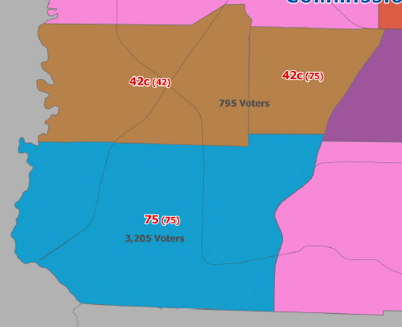
Potential Changes
Section 5 – SW Smith County Continued
Keep remainder of Pct 75 as a stand-alone pct of around 3205 active voters

Slide 26
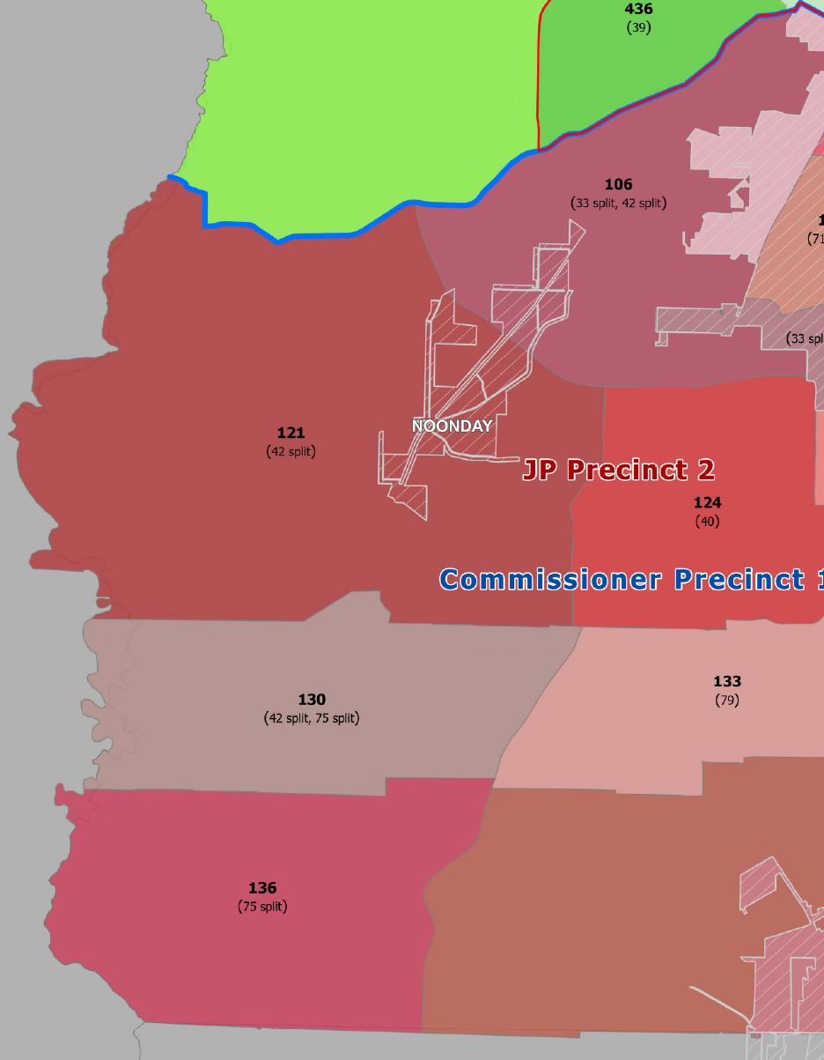
Potential Changes
Section 5 – SW Smith County Continued
Split Pct 42 into 3 parts
Section N of 49 is added to Pct 33 for around 2159 active voters (Pct 106)
Middle section of Pct 42 with around 2587 active voters (Pct 121)
Bottom section of Pct 42 split into a new pct and combined with part of Pct 75 for a total of around 795 active voters (Pct 130)
Keep remainder of Pct 75 as a stand-alone pct of around 3205 active voters (Pct 136)

Slide 27
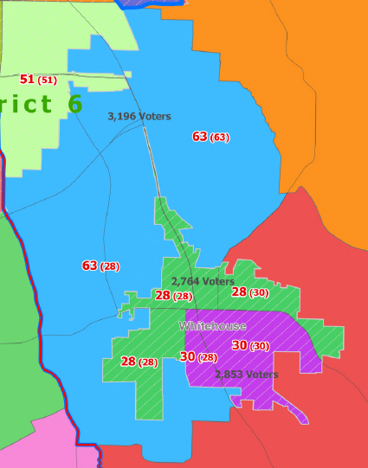
Potential Changes
Section 6 – SE Smith County
Merge unincorporated territory from Pct 28 with Pct 63 for around 3196 active voters.

Slide 28
Potential Changes
Section 6 – SE Smith County
Split Whitehouse into somewhat even partials along Main St and Willingham Rd
Pct 28 would have around 2764 active voters
Pct 30 would have around 2853 active voters

Slide 29
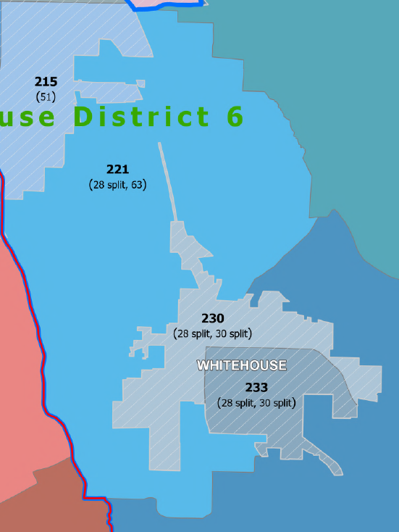
Potential Changes
Section 6 – SE Smith County
Merge unincorporated territory from Pct 28 with Pct 63 for around 3196 active voters (Pct 221)
Split Whitehouse into somewhat even partials along Main St and Willingham Rd
Pct 28 would have around 2764 active voters (Pct 230)
Pct 30 would have around 2853 active voters (Pct 233)

Slide 30
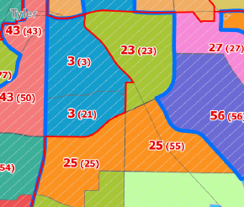
Potential Changes
Section 7 – South Central Smith County
Merge Pct 3 and 21 for a total of around 3794 active voters
Merge Pct 55 and 25 for a total of around 3758 active voters

Slide 31
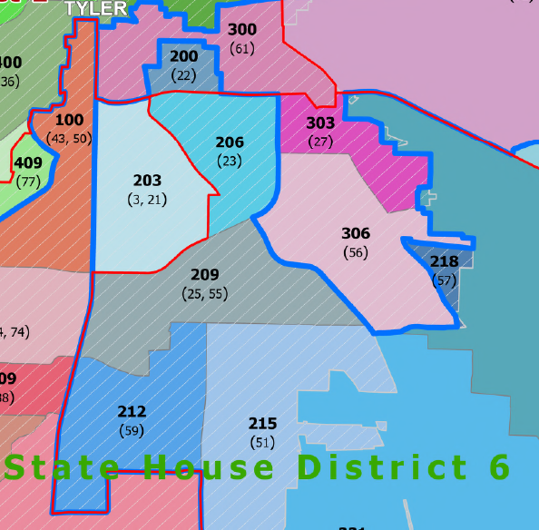
Potential Changes
Section 7 – South Central Smith County
Merge Pct 3 and 21 for a total of around 3794 active voters (Pct 203)
Merge Pct 55 and 25 for a total of around 3758 active voters (Pct 209)

Slide 32
Potential Changes
Election Precinct Renumbering
Commissioner 1 Election Precincts: 100,103,106,109…
Commissioner 2 Election Precincts: 200, 203, 206,209…
Commissioner 3 Election Precincts: 300, 303, 306, 309…
Commissioner 4 Election Precincts: 400, 403, 406, 409…
Start at the center of Tyler with smaller numbers and radiate out to the edge of the County increasing the numbers
Skip numbers to allow for growth

Slide 33
Precinct Chairs and Potential Changes
The precincts I want to combine would cause multiple changes on the precinct chair level:
several precincts with chairs would have new boundaries starting 1/1/2026
some would have larger precincts, some would have contested races if two merged precincts both have candidates file for the chair position, etc
filing for precinct chair this coming fall
TEC 171.023: If there is a change in a boundary and the precinct chair no longer resides in that precinct or there are multiple precinct chairs now occupying the same precinct, this creates a vacancy in the office and the county’s executive committee can appoint someone to be the precinct chair until the June swear in date for new chairs

Slide 34
Reasons for Potential Changes
Increase registered voters per precinct to increase Ballot Secrecy
Countywide or Precinct-Based Voting
Absentee Voting
Small turnout elections
Decrease election precincts from 75 to 66
Allows for fewer polling places (33) in smaller turnout elections Primary Runoff and Constitutional Amendment election; 38 should still be used in large turnout elections

Slide 35
